Slide 1
FUNDAMENTALS OF DATA ENGINEERING (24DEA310)
Data Engineering Pipeline for Public Health Trend Prediction
Real-time data streaming using Apache Kafka & Apache Spark
Project Team
B. Vaishnavi
2420090026
S. Lahari Krishna
2420090055
K. Yasaswi
2420030053
Guide: Dr. N Sirisha

Slide 2
Abstract
Public health agencies traditionally depend on periodic, batch-oriented reporting systems to track the spread of infectious diseases across regions. Case counts are collected at fixed intervals, often daily or weekly, compiled into spreadsheets or static reports, and only then reviewed by decision-makers. By the time this information reaches the people who need it, it can already be several days old, which delays the detection of emerging outbreaks and limits the effectiveness of timely interventions. This project addresses that gap by designing and implementing a prototype real-time data engineering pipeline that shifts public health monitoring from a periodic, report-based model to a continuous, stream-based model. The system simulates live case and death reports arriving from five different regions over a sixty-day period, using a CSV dataset as the underlying source. A Python-based producer reads these records one at a time and publishes them as individual events to an Apache Kafka topic, which acts as a durable, high-throughput message queue. Kafka decouples the arrival of data from its processing, ensuring that no records are lost even if the downstream processing component is temporarily slow or unavailable. Apache Spark Structured Streaming then continuously consumes these events from Kafka, applying regional aggregation logic to compute rolling totals of confirmed cases and deaths as new records arrive, rather than waiting for a complete daily or weekly batch. The entire environment, including the Kafka broker and Spark cluster, is containerized using Docker, which simplifies local setup, ensures a consistent runtime across machines, and makes the pipeline easy to reproduce and extend. The primary objective of this work is to demonstrate, on a practical and reproducible scale, the core concepts of modern data engineering: event-driven ingestion, decoupled processing, and continuous aggregation. Rather than building a full production-grade epidemiological surveillance system, the project focuses on proving that a streaming architecture built from open-source components can meaningfully reduce the latency between when a health event occurs and when it becomes visible as a trend. This is achieved without introducing unnecessary complexity, keeping the scope narrow enough to be implemented and tested within an academic project timeline while still reflecting patterns used in real-world streaming systems. The expected outcome of the pipeline is a continuously updated view of case and death trends, broken down by region, that refreshes as new events are ingested rather than on a fixed schedule. This demonstrates faster visibility into emerging patterns, reliable decoupling between data producers and consumers, and a foundation that can be extended in the future with persistent storage, visualization dashboards, or automated alerting. By working directly with Kafka and Spark rather than relying on pre-built dashboards or third-party platforms, the project also serves as a hands-on exploration of the tools and design patterns that underpin large-scale, real-time public health monitoring systems used by hospitals, research groups, and government health departments. While the current prototype uses simulated data rather than live feeds from hospitals or laboratories, the underlying pipeline design, event-driven ingestion, topic-based decoupling, and continuous regional aggregation, mirrors the architecture used in production-grade surveillance systems, making the project a meaningful stepping stone toward more advanced, real-world deployments.
2

Slide 3
Problem Statement
The Problem
Our Approach
Public health agencies often rely on periodic, static reports to track disease spread.
By the time data is compiled and analyzed, it can already be several days old.
Delayed visibility limits how quickly emerging outbreaks can be detected and acted on.
Simulate live case and death reports arriving from multiple regions.
Stream each record through Apache Kafka to decouple arrival from processing.
Process continuously with Apache Spark to produce rolling regional trends.
3

Slide 4
Project Objectives
1.
Simulate live input
Read sample health records and send them one at a time as streaming events.
2.
Build a reliable stream
Use Kafka to separate data arrival from downstream processing.
3.
Process continuously
Use Spark Structured Streaming to aggregate cases and deaths by region.
4.
Surface trends quickly
Produce rolling totals that update as new events arrive.
6

Slide 5
Literature Survey (1/2)
1. Ed-daoudy, A. & Maalmi, K. (2019) — A New IoT Architecture for Real-Time Prediction of Various Diseases Using Machine Learning on Big Data. Journal of Big Data.
(https://scholar.google.com/scholar_lookup?title=A+new+Internet+of+Things+architecture+for+real-time+prediction+of+various+diseases+using+machine+learning+on+big+data+environment&author=Abderrahmane+Ed-daoudy&author=Khalil+Maalmi&publication_year=2019)
Streams health events from wearable/IoT sources through Kafka topics into Spark, where a parallelized decision-tree model performs real-time disease prediction and alerting — a similar Kafka-to-Spark ingestion pattern to ours, extended with an ML classification layer.
2. Sandha, S. S., Kachuee, M. & Darabi, S. (2017) — Complex Event Processing of Health Data in Real-Time to Predict Heart Failure Risk and Stress. arXiv, UCLA.
(https://scholar.google.com/scholar_lookup?title=Complex+Event+Processing+of+Health+Data+in+Real-time+to+Predict+Heart+Failure+Risk+and+Stress&author=Sandeep+Singh+Sandha&author=Mohammad+Kachuee&author=Sajad+Darabi&publication_year=2017)
Multiple Kafka producer clients stream user health data continuously; Spark Streaming processes it across varying window sizes to detect health-related "complex events" — reinforces Kafka as the decoupling layer between many producers and one processing engine.
3. AlMohimeed, A. (2025) — Cloud-Based Real-Time Enhancement for Disease Prediction Using Confluent Cloud, Apache Kafka, Feature Optimization, and Explainable AI. PeerJ Computer Science.
(https://scholar.google.com/scholar_lookup?title=Cloud-based+real-time+enhancement+for+disease+prediction+using+Confluent+Cloud%2C+Apache+Kafka%2C+feature+optimization%2C+and+explainable+artificial+intelligence&author=Abdulaziz+AlMohimeed&publication_year=2025)
Moves the Kafka layer onto a managed cloud service and adds feature selection plus explainable-AI on top of the stream, pointing to how a prototype like ours could scale toward a production deployment.
4

Slide 6
Literature Survey (2/2)
4. Pendyala, V. S., Kapadia, M., Periyapatnaroopakumar, B., Anandani, M. & Nagendran, N. (2025) — A Big Data Pipeline Approach for Predicting Real-Time Pandemic Hospitalization Risk. Algorithms (MDPI).
(https://scholar.google.com/scholar_lookup?title=A+Big+Data+Pipeline+Approach+for+Predicting+Real-Time+Pandemic+Hospitalization+Risk&author=Vishnu+S.+Pendyala&author=Mayank+Kapadia&publication_year=2025)
Builds a dual streaming pipeline for pandemic hospitalization-risk prediction directly from CDC surveillance data, adding a Bloom filter for fast pre-screening — closest in spirit to our project's public-health framing, though focused on individual patient risk rather than regional trend aggregation.
What this project takes from prior work
Kafka as the standard decoupling layer between data producers and stream processors, used consistently across all four studies.
Spark (Streaming / Structured Streaming) as the processing engine for continuous aggregation and analytics.
Most prior work adds a prediction/ML layer on top of the stream; this project instead focuses on getting the core streaming pipeline and regional aggregation right, as a foundation for that layer later.
5

Slide 7
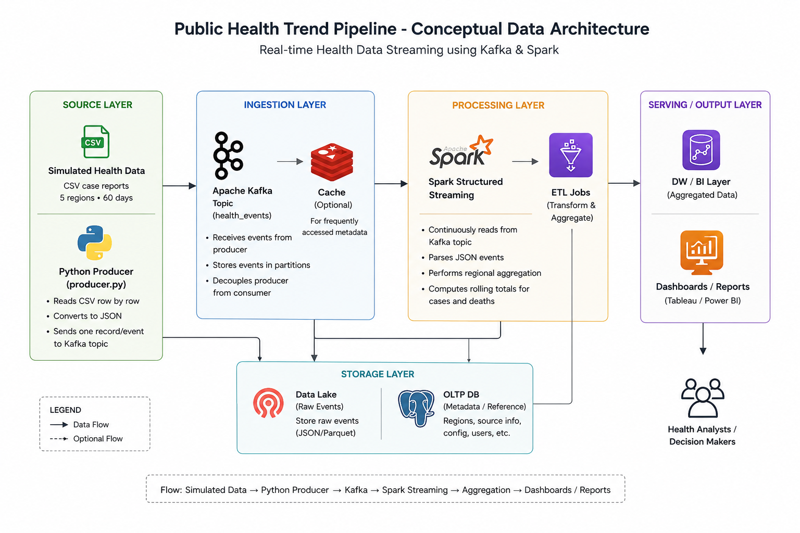
Simulated
Health Data
Kafka
Topic
Spark
Streaming
Rolling
Trends
CSV case reports
5 regions • 60 days
Producer sends
one record/event
Continuous consume
+ regional aggregation
Live case/death
totals by region
Why this design?
Kafka decouples “data arriving” from “data being processed,” helping prevent data loss when processing is temporarily delayed.
8

Slide 8
Tools & Technology Stack
Tool | Role | Description
Apache Kafka | Real-time message queue | Receives each case report as an event and holds it until Spark processes it.
Apache Spark | Structured Streaming | Consumes Kafka events continuously and aggregates rolling case/death totals.
Python | Data producer | Reads sample health records and sends them to Kafka one record at a time.
Docker | Environment setup | Runs Kafka and Spark in ready-made containers, simplifying local setup.
7

Slide 9
Expected Outcomes
✓
Faster visibility
New events can be processed continuously rather than waiting for a full batch.
✓
Regional trends
Rolling case and death totals can be maintained separately for each region.
✓
Reliable decoupling
Kafka separates incoming data from Spark processing.
✓
Scalable foundation
The architecture can be extended with storage, dashboards, or alerts.
9

Slide 10
Thank You

